Slide 1
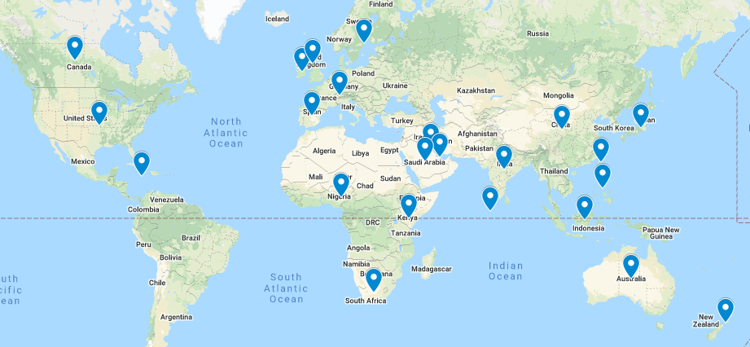
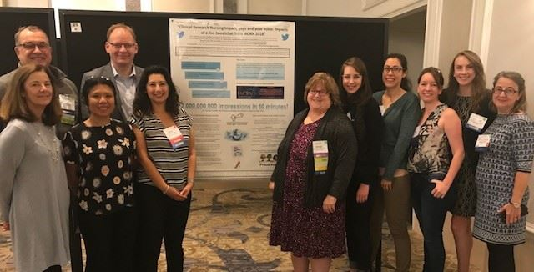
IACRN Membership Marketing and Communication Committee
The MMC supports the mission and vision of IACRN through the management of internal and external
communications, membership promotions, and marketing of the organization.
FUTURE MMC PLANS: Grow membership to 500 by 2022 conference! Upgrade website. Enhance Social Media globally.
Committee Members
IACRN Membership
We need you!
Chair: M. Terry Jeffs-Georgetown University
Laura Baker, Board Liaison-Seattle
Children's Hospital
Brian Beardslee-Dana Farber Cancer
Institute
Doyle Bosque- MD Anderson Cancer Center
Gordon Hill-Glasgow Caledonian University
Catherine Ricciardi-MIT Clinical Research Center
Members: 441 Represented Countries: 23
Come join our dynamic group with your talents
for improving strategies for marketing,
website upgrades & communications.
Committee Meetings via Zoom
Second Tuesday of each month
10am-11am EST
Email: M. Terry Jeffs jeffsm@georgetown.edu
Engage with IACRN – Please click the audio icon to hear how you can join the MMC!
1338 followers
2017 followers
#IACRN21
917 members
41 followers
Enhancing clinical research quality and safety through specialized nursing practice.

